Slide 1





Customer Churn Analysis and retention strategy
E-commerce

Slide 2


Prepared by:
1
Yousef Mohamed Abass
2
Nourine Mostafa Ibrahim
Supervised by:
3
Jana Medhat Mostafa
Amira yousef
4
Salma HamdyAbdelfattah
5
Jana Ahmed Mohamed
6
Jomana Wael Mahmoud

Slide 3
Data Quality Issues
Duplicate
Null
Duplicate records occur when the same data entry appears more than once, such as the same customer, order, or value repeated unnecessarily.
Null values are empty or missing fields in the dataset
( missing name, missing price, empty date, .…)

Slide 4
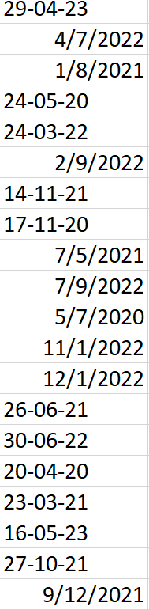
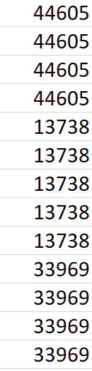
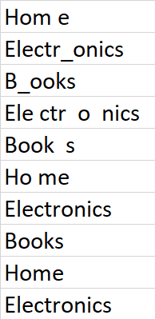
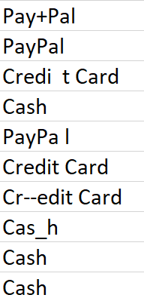
Unifying Data Formats
The dataset contained inconsistent formatting across multiple fields
Multiple date formats
Numbers stored as text
Names with inconsistent capitalization
Extra symbols and unwanted spaces in text fields

Slide 5
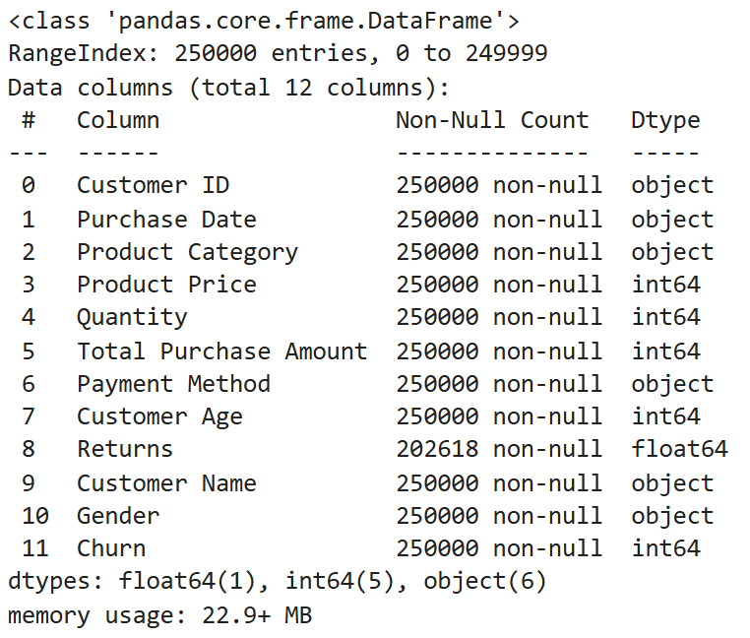
What We Did ?
1
Converted numeric fields to Number
2
Converted date fields to Date type
Ensured each column matches the correct data type
3
Applied consistent capitalization rules to names
4

Slide 6
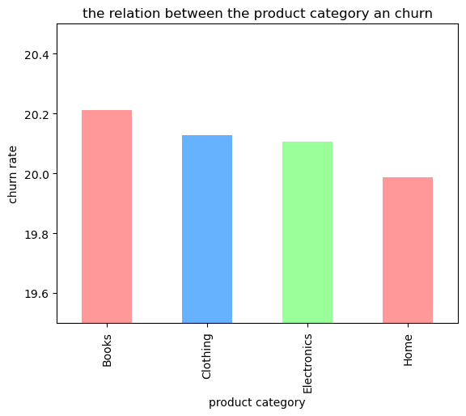
VISUALISATIONS
• Customer churn rates across all product categories are very similar (around 20%).
• Product category does not strongly affect whether customers churn.
• Books category has the highest churn rate (about 20.2%).
• Clothing and Electronics follow closely (around 20.1%).
• Home products have the lowest churn (just under 20%).
• Key takeaway: Minimal differences suggest churn is likely driven by factors like service quality, pricing, or customer experience—not the product type.

Slide 7
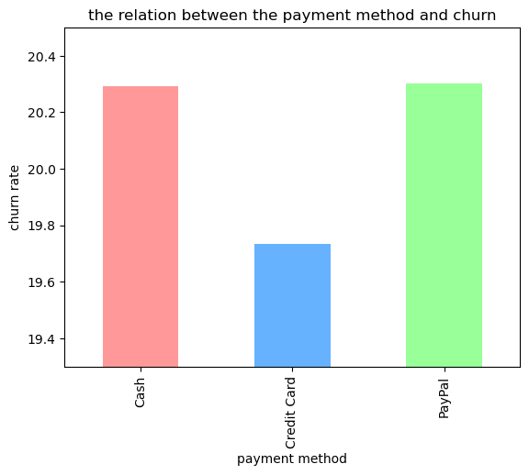
• Churn rates differ slightly across payment methods.
• Credit Card users have the lowest churn (about 19.7%), suggesting higher loyalty or repeat purchase behavior.
• Cash and PayPal users have higher churn rates (slightly above 20.2%).
• Higher churn among Cash and PayPal users may indicate lower long-term engagement.
• Key takeaway: Credit card payments are linked to better customer retention, while Cash and PayPal users churn at slightly higher rates.

Slide 8
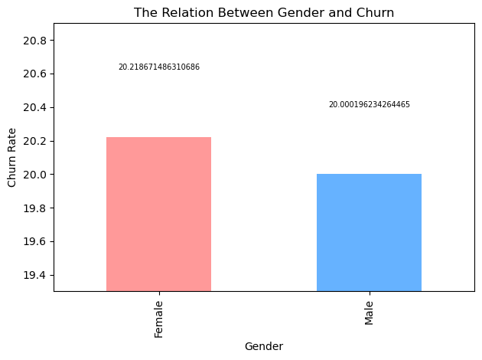
• Churn rates for male and female customers are very similar.
• Female customers have a slightly higher churn rate (around 20.22%).
• Male customers have a slightly lower churn rate (around 20.00%).
• Gender does not significantly influence churn.
• Key takeaway: Churn is likely driven by other factors—like experience, satisfaction, or pricing—rather than gender.

Slide 9
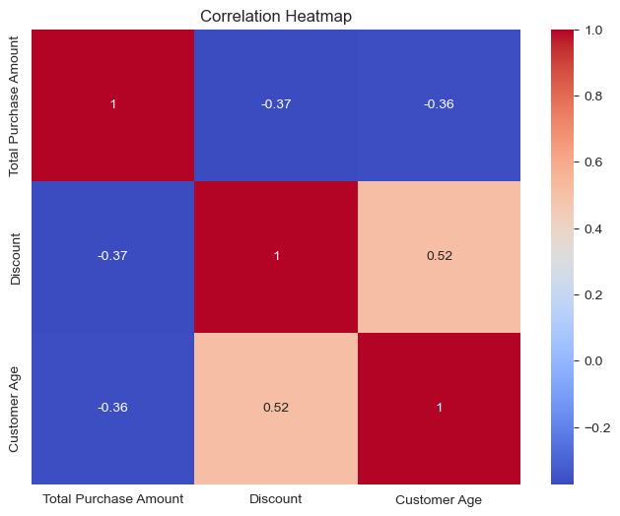
• The correlations between the variables are generally small, indicating no strong direct relationships.
• Total Purchase Amount & Discount: Moderate negative correlation (–0.37) — customers spend slightly less when discounts increase.
• Total Purchase Amount & Customer Age: Moderate negative correlation (–0.36) — older customers tend to spend a little less.
• Discount & Customer Age: Moderate positive correlation (+0.52) — older customers are more likely to receive higher discounts.
moderate—not strong.
• Purchase amount, age, and discount levels are related, but none can reliably predict the others.
• Customer behavior is influenced by multiple factors, not just age or discount level.
• Insights can help with targeted promotions and customer segmentation.
• Deeper analysis may be needed to fully understand what drives spending and discount patterns.

Slide 10
Data warehouse
In Our Project, We used a Data Warehouse A data warehouse is a centralized system that collects and organizes information from different sources. In our case, it optimizes for structured and relational data such as customer, product, purchase, and purchase details data into one analytical environment.
Why we use data Warehouse?
1
It provides a single source of truth for analysis and reporting.
It supports customer churn prediction, sales trend tracking, and product performance evaluation.
2
3
It stores historical data, enabling comparisons over time.
It reduces complexity by separating analytics from daily operational systems.
4

Slide 11
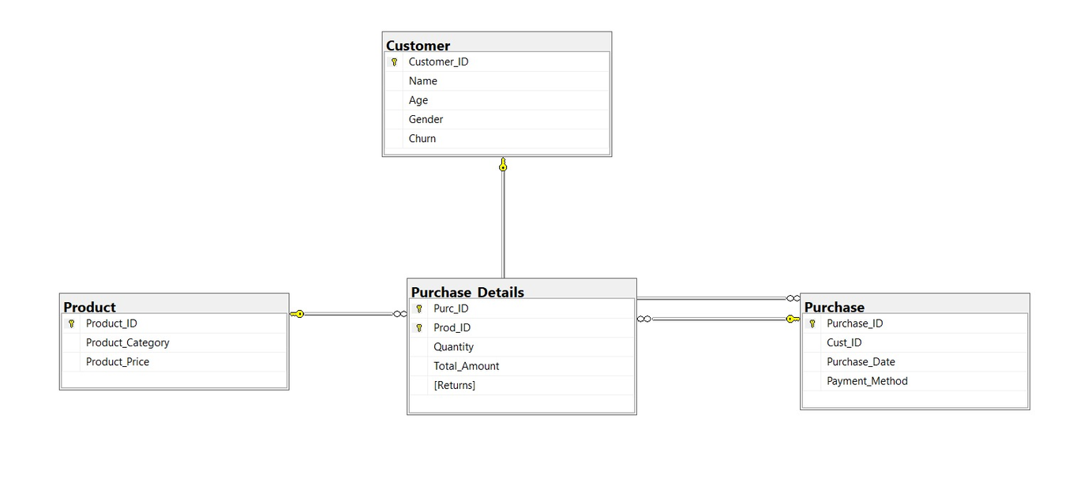
Schema Overview (Star Schema)
Schema Structure in Our Data Warehouse:
Our schema is designed to support analytical queries about customer behavior, product performance, and purchase trends. It follows a star schema layout with fact tables at the center and dimension tables around them. Star schema enabling multi-angle analysis across customer, product, and purchase dimensions. It supports churn prediction, and product insights.
Key Components:
  Customer Dimension
  Product Dimension
  Purchase Dimension
  Purchase Details Fact Table
Gather Data
How it Supports Analytics?
  The structure links purchases with customers and products , enabling a complete view of customer behavior.
  It allows analysis of sales trends, churn patterns, return rates, and product demand.
  It organizes data in a way that supports efficient batch processing and reliable reporting.
  Ensures consistent, accurate insights for dashboards and data-driven decision-making.

Slide 12
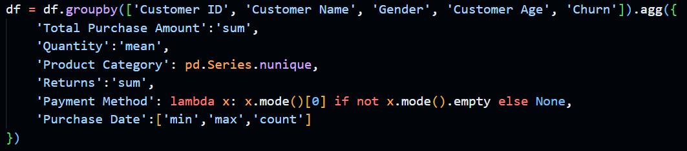
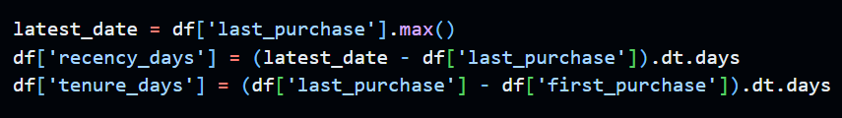
Data Preprocessing & Feature Engineering
I. Customer-Centric Feature Engineering
  Financial Metrics: Calculated the total_spent (sum of purchases) and avg_quantity (mean quantity per order).
  Loyalty Features: Derived time-based metrics:
    Recency (recency_days): Days since the last purchase.
    Tenure (tenure_days): Total duration of the customer relationship.

Slide 13
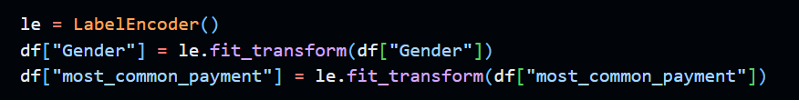
Data Preprocessing & Feature Engineering
II. Encoding & Model Setup
  Categorical Encoding: Non-numeric features (Gender and most_common_payment) were converted to numerical labels using Label Encoding.
  Data Split: The final dataset was split into training (80%) and testing (20%) sets, separating features (X) from the Churn target variable (Y).

Slide 14
Machine Learning Model & Evaluation
The objective was to predict customer churn using four classification algorithms: Logistic Regression (baseline), XGBoost, Random Forest, and LightGBM.
The initial model run produced high overall accuracy but failed to effectively identify the minority class (churning customers).
  Overall Accuracy: Approximately 80% across all models.
  Root Cause: This high accuracy is misleading and primarily attributed to the severe class imbalance in the dataset (only around $20% churn rate). By predicting "No Churn" for most cases, the model achieves 80% accuracy.
  Minority Class Performance: All ensemble models (XGBoost, Random Forest, LightGBM) exhibited poor performance on the churn class, with F1, Precision, and Recall scores near 0.0.
  Baseline Behavior: The Logistic Regression baseline's performance suggests it defaulted almost entirely to predicting the majority class ("No Churn").

Slide 15
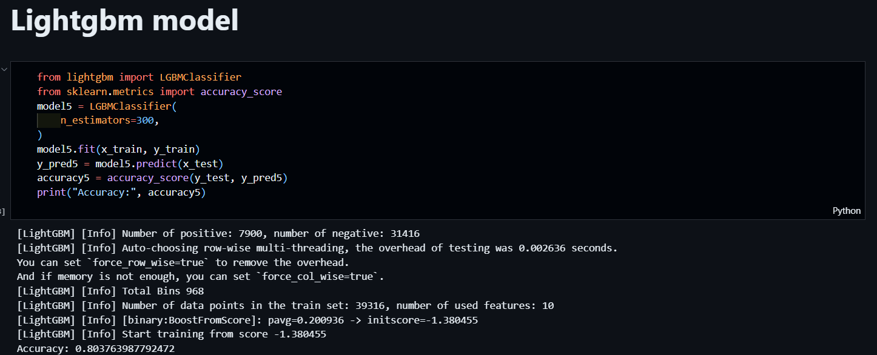
Machine Learning Model & Evaluation

Slide 16
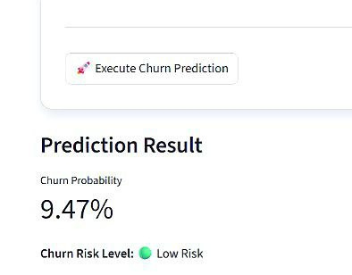
Streamlit Implementation
Prioritize and Plan
  Single-customer input form for instant scoring.
  Display predicted churn probability with risk levels.
  Visual insights: churn distribution, feature importance, and key metrics.
  Downloadable prediction results.

Slide 17
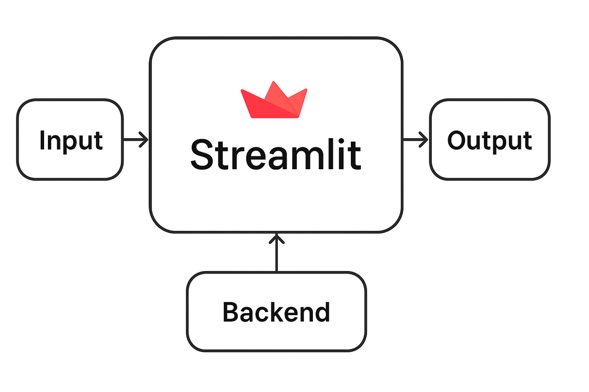
Why Streamlit?
  Real-Time Interaction
  Simple Model Integration
  Clean UI With Minimal Effort
  Faster Iteration & Prototyping
  Easy Sharing & Deployment
  Built-in Support for Visualizations

Slide 18
conclusion and retention strategy
  Churn is mainly driven by behavioral factors:
  payment method, engagement level, product interest, age segment, and service experience.
  Customers respond best to mid-range value offers (150–400) instead of heavy discounts.
  Digital payment users churn less, while cash users churn more due to payment friction and lack of auto-renewal.
  Age matters: core customers (30–57) seek reliability, while younger customers (18–29) require modern, digital-first engagement to build loyalty.

Slide 19
Recommendations and retention strategy
  Shift customers from cash → digital payments using proactive incentives.
  Implement fast, frictionless checkout (e.g., One-Click Pay / digital wallets).
  Create personalized mid-range bundles aligned to typical spending behavior.
  Build category-specific loyalty & retention funnels for targeted engagement.
  Use predictive churn flags and customer stability scoring to trigger early retention support.
  Apply age-based messaging:
  Older segments → reliability, quality, guarantees
  Younger segments → trends, speed, social proof, influencers

Slide 20
Thank You
If you have any questions, I’ll be happy to answer them.

